Slide 1


22ECW301: Project lab-I
(V Semester)
Department of Electronics and Communication Engineering
Presented By : Devashish Tushar
(2022uec1487)
MNIT Jaipur

Slide 2
1
MICROSTRIP PATCH ANTENNA DESIGN :
X AND KU BAND
This presentation details the design and simulation of a microstrip patch antenna, specifically for X Band(8GHz to 12GHz) and Ku band(12 GHz to 18 GHz) applications, using CST Studio Suite software..
MNIT Jaipur

Slide 3
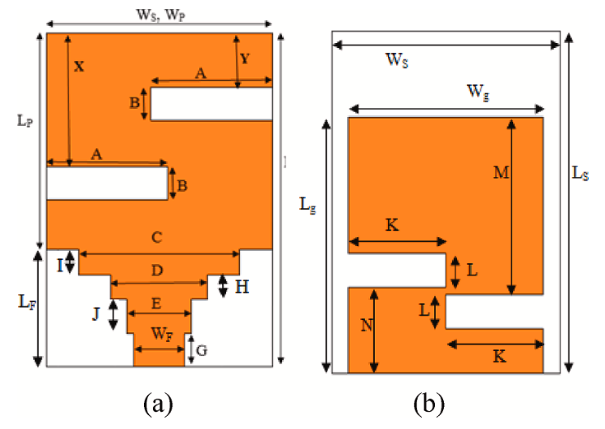
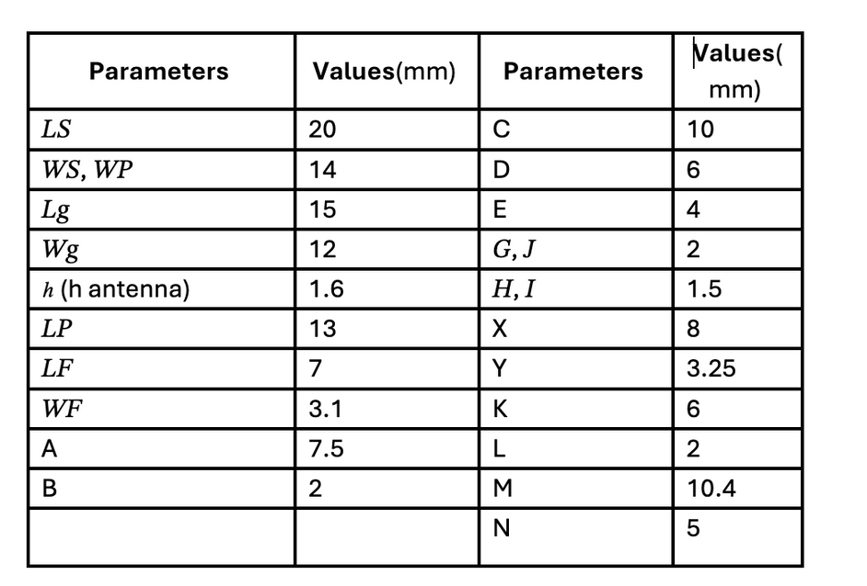
2
DESIGN SPECIFICATIONS
MNIT Jaipur

Slide 4
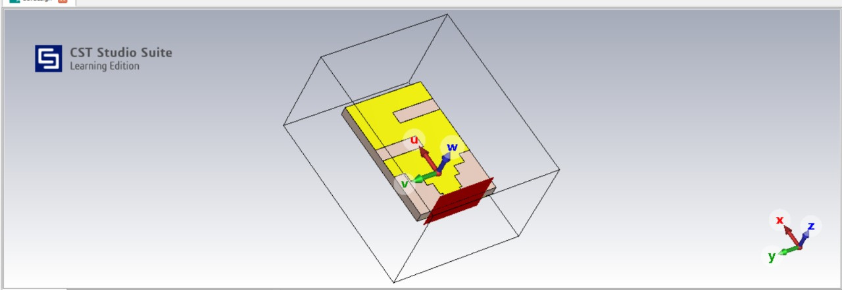
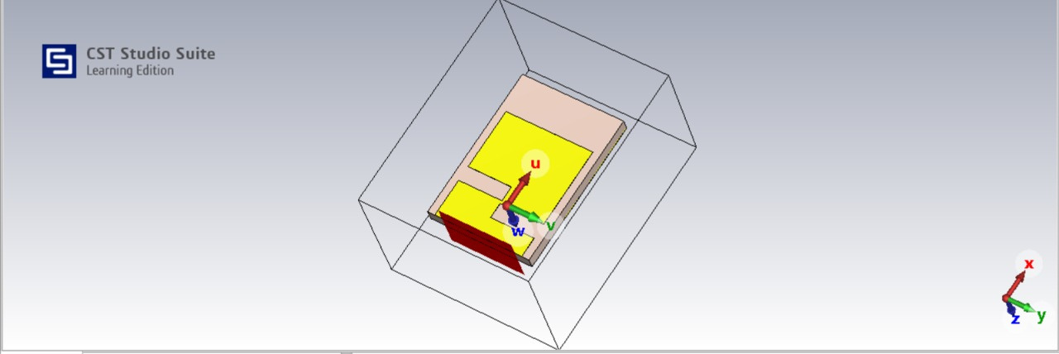
3
The Schematic presents the design of a high-gain broadband microstrip patch antenna for X, and Ku band applications. It features a rectangular patch (13 × 14 mm) on an FR4 substrate
(20 × 14 × 1.6 mm) with a partial ground plane made of PEC material. Key enhancements include slot loading in the patch and ground, along with a modified microstrip feed structure to achieve broadband characteristics, improved impedance matching, and low return loss (S11 < -10 dB). The design balances manufacturability and performance, leveraging the favorable properties of FR4 and PEC materials.
MNIT Jaipur

Slide 5
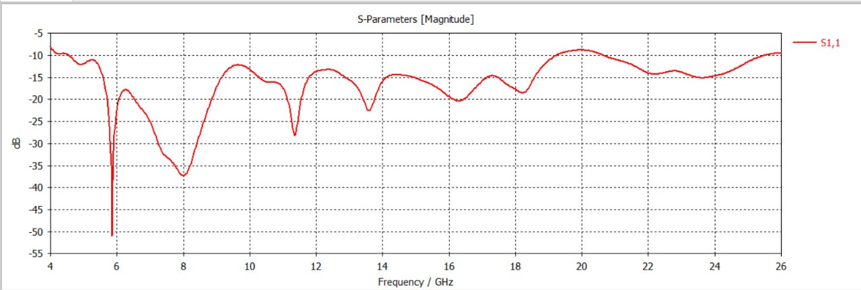
5
RESULTS.
Desirable Bands are obtained between 10-12 GHz and 12-14 GHz

Slide 6
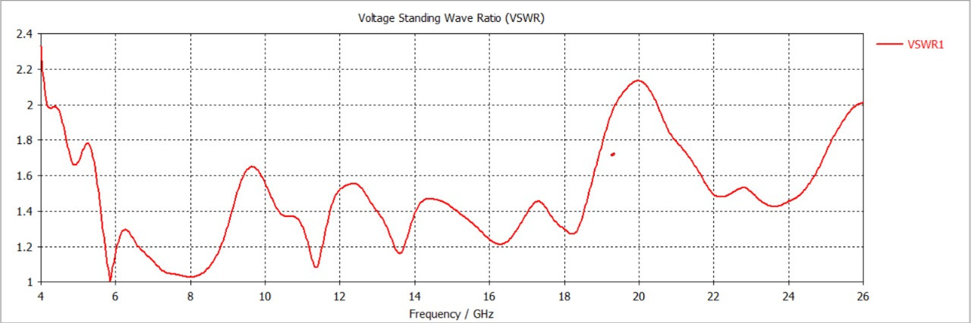
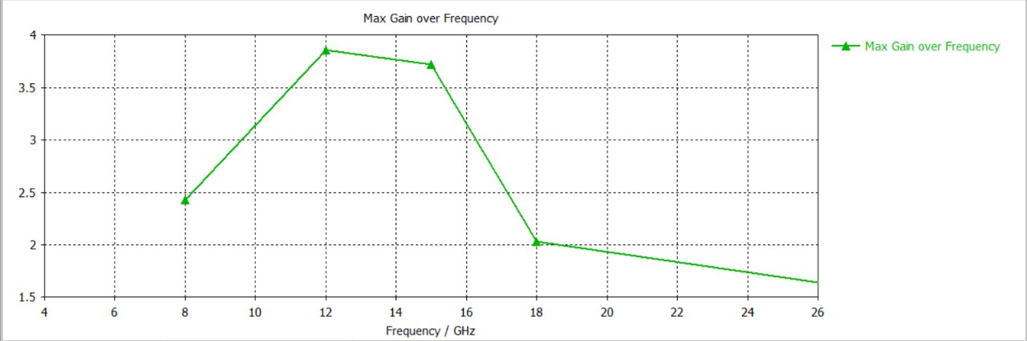
6
VSWR
Max Gain over Frequency
MNIT Jaipur

Slide 7
8
CONCLUSION
This project successfully demonstrates the potential of microstrip patch antennas in addressing the growing demands of high-frequency communication technologies. The compact design make this antenna a viable solution for Ku band X band applications. The research highlights the importance of careful engineering and advanced simulation techniques in antenna design.
MNIT Jaipur

Slide 8
THANK YOU

